Slide 1


Slide 2
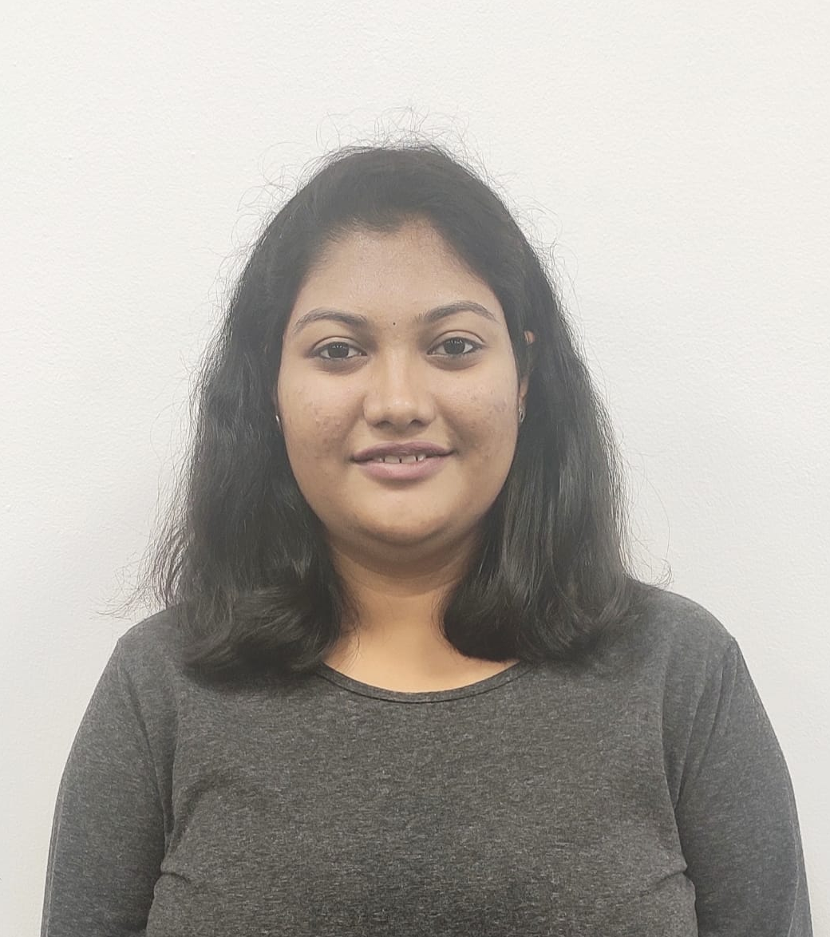
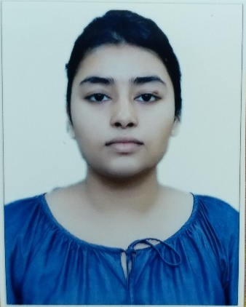
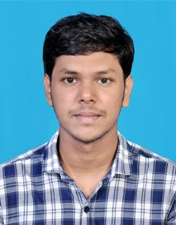
Project Highlights
Project Name : Web Development Project -> OpenGrills Catering Services
Team Size : 4
BU Mentor Name : Mentor PS#
Team Members Details:
Chandana AN
99002674
2009MYSSPSB1
Computer Science
HTML, CSS, JS, Java, C, SDLC, SQL
Shruti Hazra
99002643
2009MYSSPSB1
Computer Science
HTML, CSS, JS, Python(Basics), C, SDLC, SQL
Pradeep V
99002647
2009MYSSPSB1
Computer Science
C,C++, HTML, CSS, JS

Slide 3
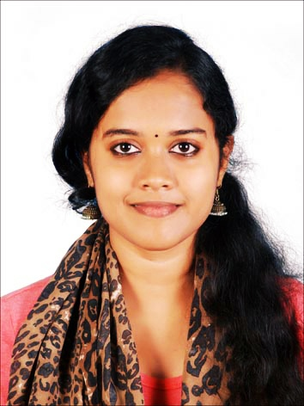
Team Members Details:
Aneena Fernandez
99002650
2009MYSSPSB1
Computer Science
HTML, CSS, JS, C, Python, SDLC, SQL

Slide 4
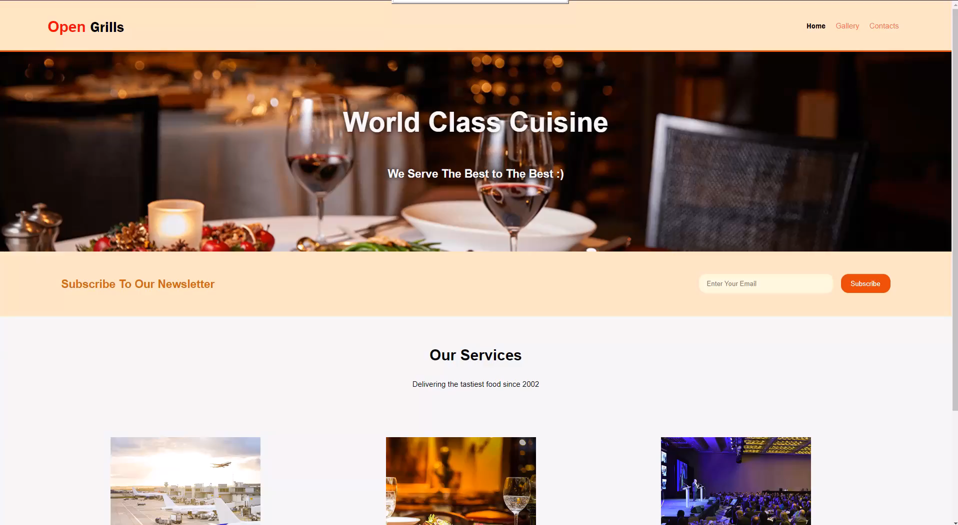
Project Video Snippet

Slide 5
Future development that can be implemented further
Whenever a customer subscribes to the newsletter, they must receive a reply from backend in the form of an email.
Images can be made clickable, so that they open as a pop up.
Enable zooming of images present under Gallery tabs.
Incorporate a ChatBot to interact with any customer with queries.

Slide 6


Thank You !

